Slide 1

Optimizing Your Transportation Needs

Slide 2

Globalized World
The world is becoming a smaller place
Increasing trend in travel
Transportation is not just local anymore

Slide 3

Market Research
Surveying the market needs and wants

Slide 4
Do you think there is a need for an app that assist your travel group in finding the most appropriate time and venue of the trip?
* Percentage based on the 70 person who did the survey
Notes:
Out of 61 person who does the survey

Slide 5
Will you be benefited by an app that helps you plan your trip more effectively by minimizing the travel time?
* Percentage based on the 70 person who did the survey

Slide 6
Objectives:
To help people plan collaboratively and travel more effectively.
Travel Itinerary
Optimization of travel (best transportation and route)

Slide 7
OUR PROCESS
Group Formation
Travel Selection
Route
Optimization

Slide 8
Route Optimization
Distance and Time Optimization
Calculate, provide and suggests the users the best transportation route based on the distance and predicted time
Reminders and Warnings
Remind the users of peak hour times to avoid travelling during congested hours
Carpool
Smaller groups could pool together and use a bigger vehicle to reduce the number of vehicles on the road

Slide 9

Possible Collaboration with Uber
All the cities available on the data base have access to ride Uber

Slide 10
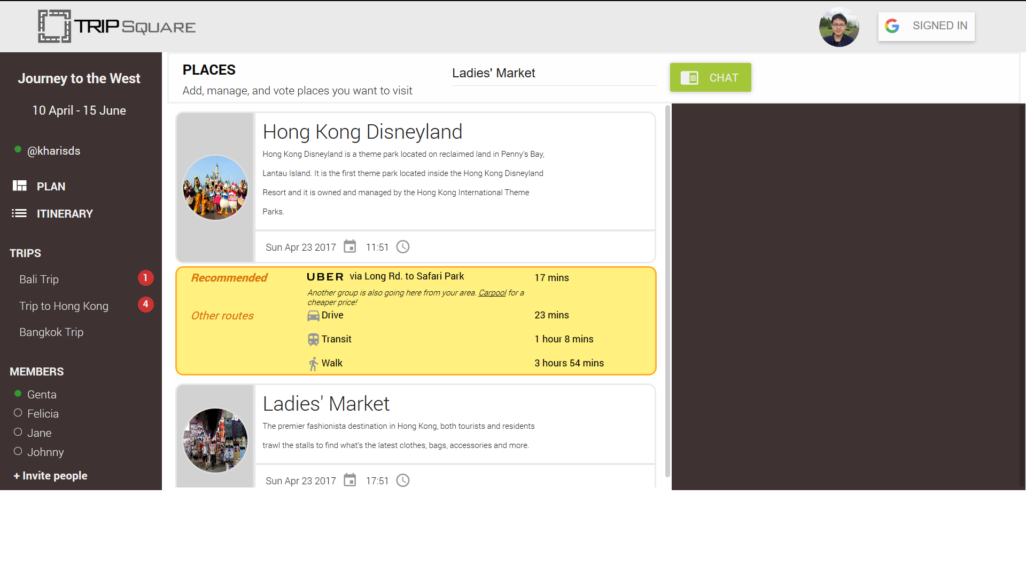
Possible Collaboration with Uber

Slide 11
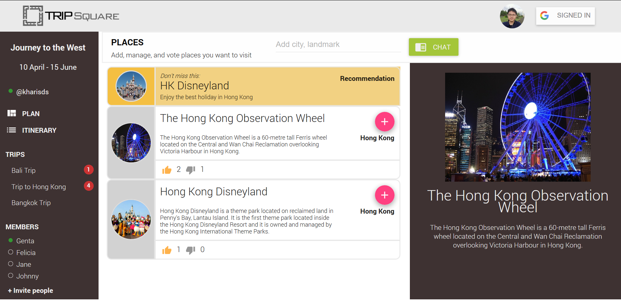
Place your screenshot here
Demonstration Time

Slide 12
THANK YOU!
Any questions?

Slide 13
API Used for the Program
Google Direction API
Used to obtain the mode of transport, way points and travel time datas and calculate the optimum one.
Google Sign In API
To allow the users to sign in using their google account for ease of access.

